Slide 1


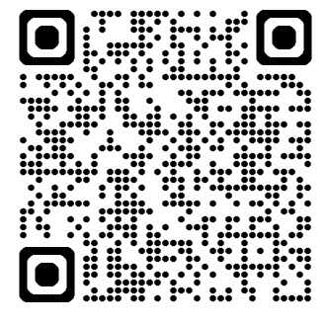
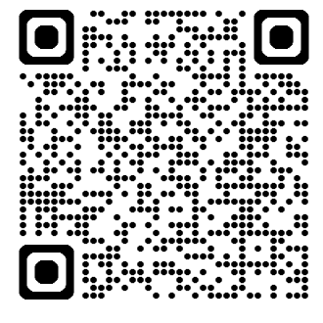
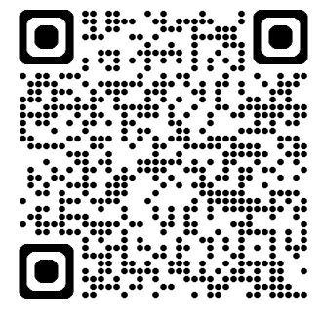
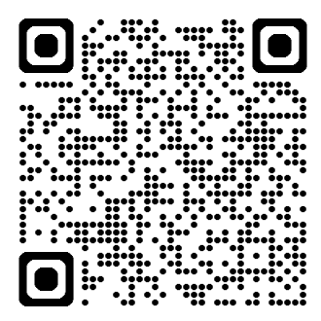
Tips For Wellness
Mental Health in Schools Team
Growing for wellbeing week - 3rd - 9th June
Get outdoors
Being outside can help decrease your anxiety levels, as well as lessen stress and feelings of anger. Exercise can also help with this and it's even better when you're outside!
Regular access to green spaces has been linked to lower risks of depression and improved concentration and attention. Cycling and walking both release our 'feel-good' hormones known as endorphins. These hormones help to relax your mind and make you feel happier. This boosts your mood and reduces your feelings of anxiety. Research shows that those who regularly cycle also have a significantly lower risk of feeling stressed!
Our tips for getting outdoors:
Check out the QR code for 75 fun outdoor activity ideas! There are some great suggestions for things you can do outdoors during the summer holidays, why not create your own ‘summer holiday bucket list’ of all the activities you would like to try?
Have a look in your local area for any parks or green spaces you can go to. Some parks have a variety of activities you can do, such as football, mini golf, tennis and foot golf! Follow the QR codes for some suggestions.
Try a new outdoor activity, such as disc golf! There are disc golf courses available in Stratford (Gilly’s Disc Course) and Leamington (Quarry Park Disc Golf Course).
Follow the QR code below to the best trails in Warwickshire, where you can walk, mountain bike or climb outdoors with family and friends. There are plenty routes to choose from!
75 outdoor activities!
Coombe Abbey
facilities
War Memorial Park facilities
Warwickshire
trails
#ThanksKids recognises the efforts and kindness of children and young people, and thanks them with personalised #NHSStars certificates. If you know a child or young person that deserves recognition for going above and beyond, don't wait, nominate! thankskids@covwarkpt.nhs.uk.
MHST are available to support you and your school throughout the school year including term time and school holidays.
Please contact your school's Mental Health Lead for information and advice.

