Slide 1


Slide 2

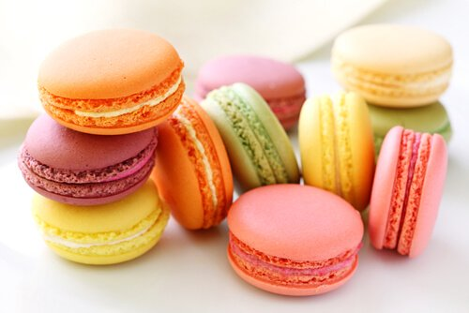

A-Level and AS French
A two-year course for A level,
a one-year course for AS
A refreshing change from GCSE !
Spontaneous, relevant, fun,
thorough and satisfying…
Notes:
NOT like GCSE
- Need to commit from the start
+ Time to develop into an A-level student before exams
Less time wasted doing 2 sets of exams

Slide 3
New skills:
Expressing
your ideas
(in speaking
& writing)
Lots of
spontaneous
speaking
Learning
about
France
Upgrading
your
grammar
Studying
set texts:
film (AS & A)
Book (A)
Translating:
Fr → Eng
Eng → Fr
Independent
Research
(A-Level)
Summarising

Slide 4
Themes
Year 12
Year 13
Current trends in French* society
Current issues in French* society
- La famille en voie de changement
- Les positifs d’une société diverse
- La “Cyber-société”
- Quelle vie pour les marginalisés?
- Le bénévolat (volunteering)
- Comment on traite les criminels
Artistic culture in France*
Aspects of political life
Une culture fière de son patrimoine
(A culture proud of its heritage)
Les ados et l’engagement politique
(Young people & political commitment)
- Musique francophone contemporaine
Manifestations et grèves
(Demonstrations & strikes)
- Le cinéma
- La politique et l’immigration
Notes:
French* - francophone

Slide 5


Study of a French film
(AS & A-level essay paper)
Independent research project
(for A-level speaking exam)
You choose your own topic
e.g.
New Wave films
Riots of May 68
Study of a French text
(A-level essay paper)
The Impressionists
Marie Curie
National Rally
French cuisine
Algerian War of Independence…
Notes:
French* - francophone

Slide 6
Examination structure: A-level
Paper 1
2½ hours
Listening (inc. writing a summary in French)
Reading
Translation into English
Translation into French
Paper 2
2 hours
Two essays: one on the film and one on the text
Paper 3
16-18 minutes(!)
Speaking
Stimulus card to discuss, based on a sub-topic
Present & discuss your research project

Slide 7
Examination structure: AS-level
Paper 1
1¼ hours
Listening (inc. writing a summary in French)
Reading
Translation into English
Paper 2
1½ hours
Translation into French
One essay on the film
Paper 3
12-14 minutes(!)
Speaking
Two stimulus cards to discuss, based on sub-topics

Slide 8
Top tips…..( avant de commencer!)
Get talking!
Revise your grammar
Practise listening to and speaking
as much French as you can
There’s a list of Present
Tense verbs to learn by heart.
Have a look on www.rhsvle.co.uk
The course is all about spontaneous
use of language, so practise,
practise, practise!
Get a copy of the grammar book
and revise the basics over the
summer.
Don’t be afraid to make mistakes
Talk at home about what’s going
on in the news, here and overseas.
Keep up with what’s happening in
France
You’ll find the start of the course
much easier if you have the
Present Tense, Perfect Tense and
Future Tense under your belt
Develop your opinions so you can
talk about a range of different
topics and write about them too
Adjectives
Learn the different endings

