Slide 1
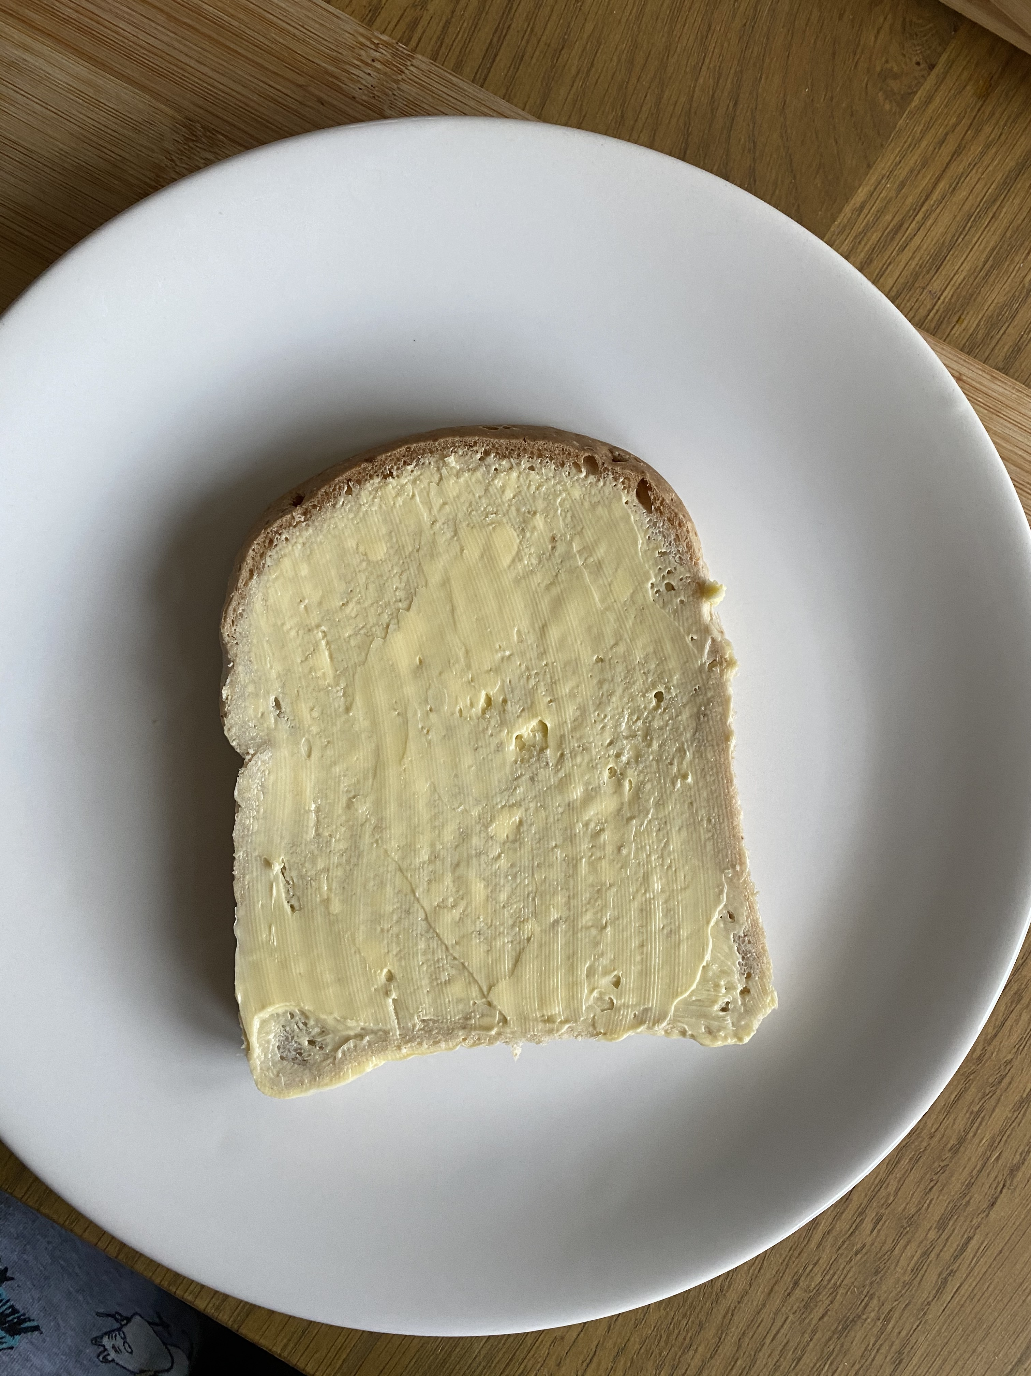
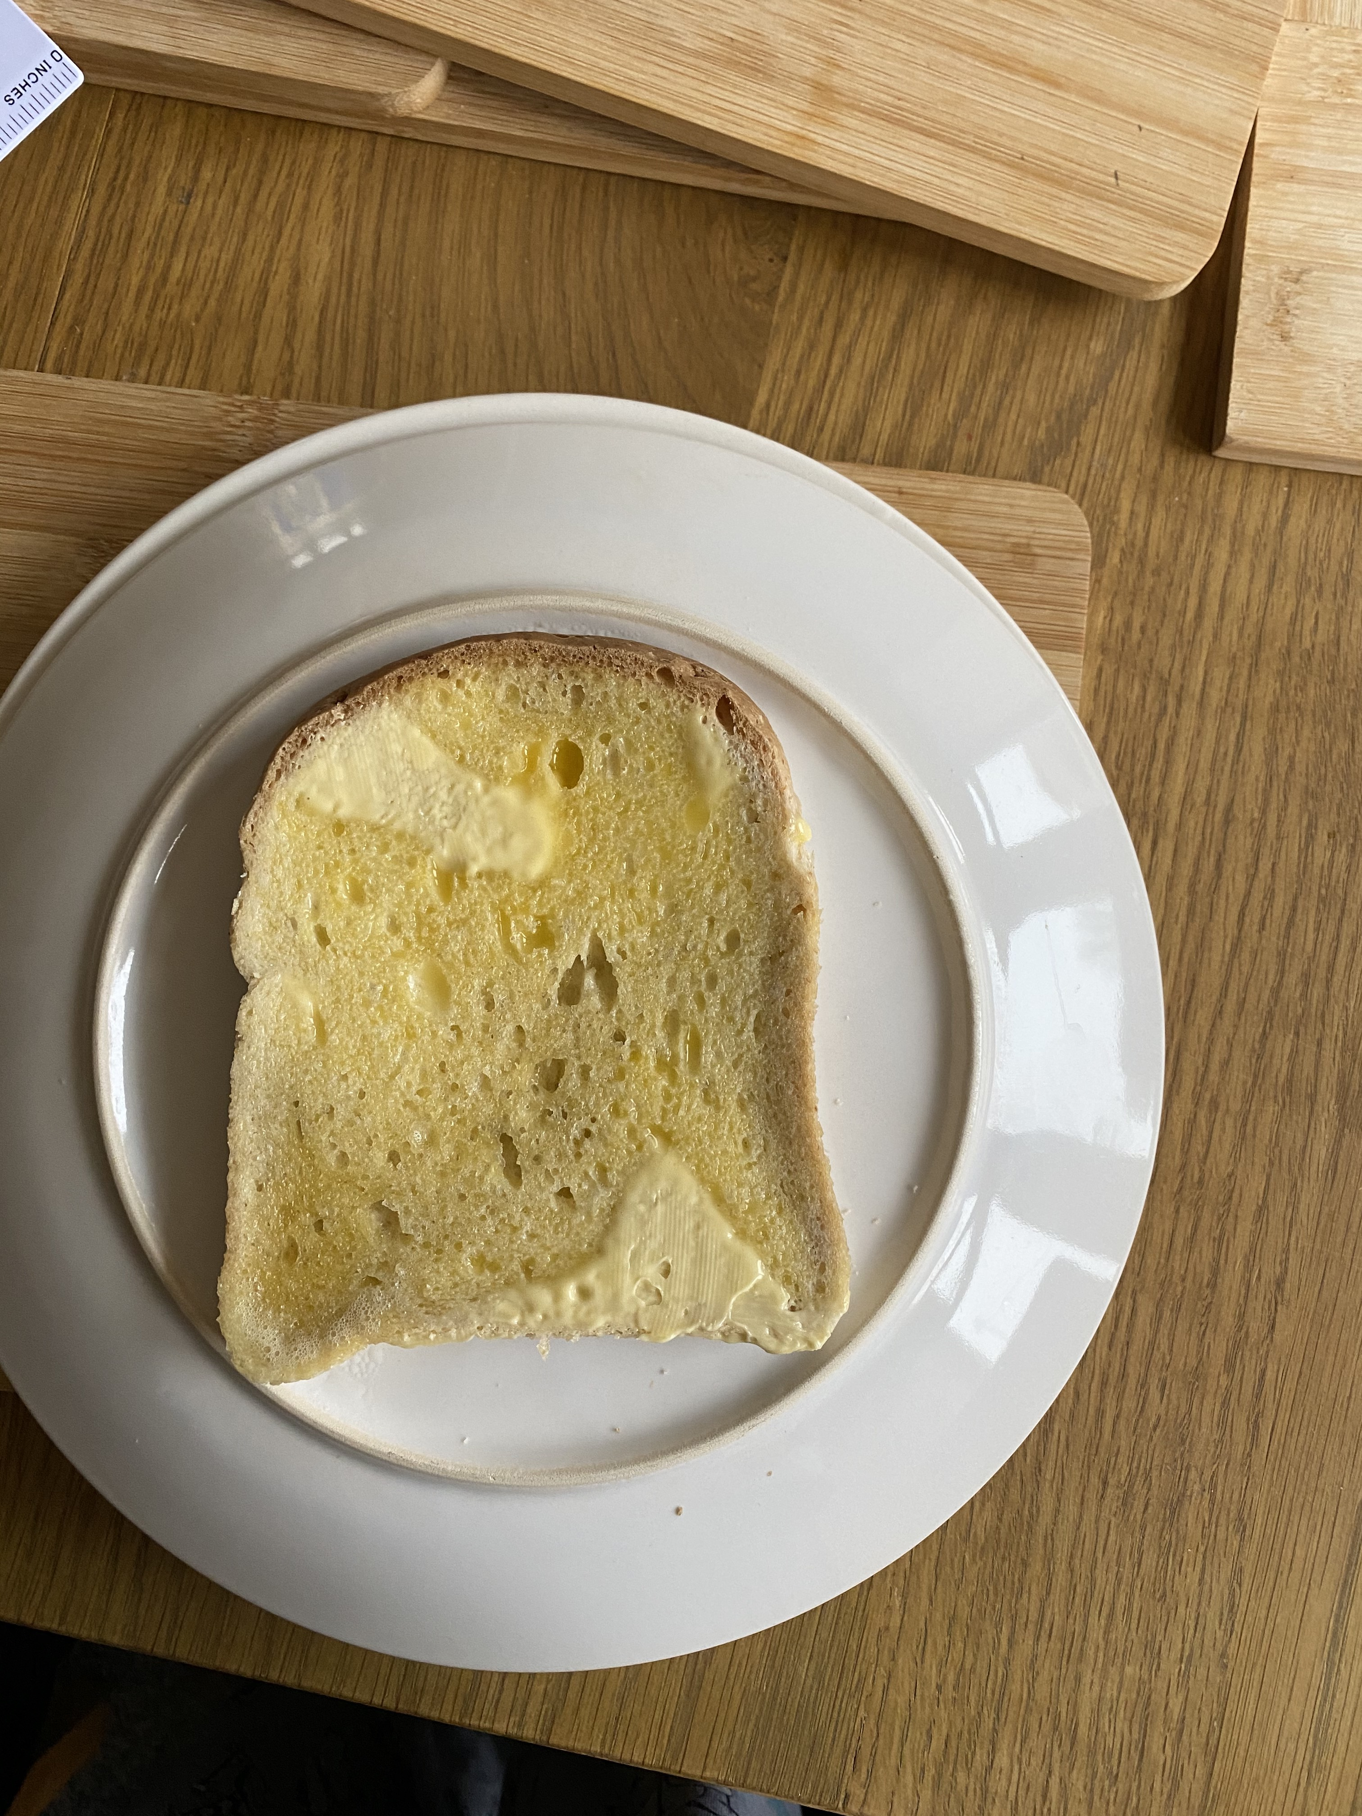
Using Standing waves to find the wavelength of microwaves experiment.
Before
After
By Natasha Shoker

Slide 2
Equipment and method
Equipment: a slice of bread, microwave oven, butter ,a plate and a ruler and calculator.
1. Get your slice of bread and put a thick layer of butter on it.
2. Remove the turntable from the microwave.Then place a plate upside-down over the microwave’s rotator to stop it from rotating.Place the slice of bread on top of the plate and put in the microwave for 20 seconds.
3. When you remove the dish, you’ll notice only certain parts are melted. However, the time will depend on the microwave – if all or none of the butter is melted, adjust the time.
4. Measure the distance between melted spots on the bread using a ruler. Measure in centimetres. This is half the wavelength of a microwave.
5.Look for a sticker on your microwave that tells you its frequency in Hertz and calculate the speed of light.

Slide 3
Calculations
Convert your distance between melted spots from cm to m
7cm = 0.07m
Find the frequency for your microwave in Hertz
2450 * 10^6 Hz
Calculate the speed of light using the equation
Speed of light = 2 *(distance between melted spots) *(frequency of microwave)
2 * (0.07) * (2450 * 10^6) = 3.43 * 10^8 ms-1
Check how close your value is to the speed of light as the actual value is 3 * 10 ^ 8 ms-1

Slide 4
Accuracy and evaluation
Percentage difference from accepted value
%D(v) = (0.43 * 10^8 / 3.0 * 10^8) * 100 = 14.3%
Accurate measuring techniques: However,next time to make sure that when you are measuring the distance between the two melted spots accurately measure the distance between the two spots three times and calculate a mean for this distance and use a ruler with a larger resolution.
Evaluation: Overall, the experiment went okay as my value is quite similar to the calculated value however it is not an accepted value as the percentage difference is 14.3% and it needs to be 5% or below to be an accepted value.However,you could also use different foods (cheese or chocolate or different spreads on bread)to see how much this affects your value or use several pieces of bread and repeat the experiment to see if you get more accurate results.

Slide 5
References
For experiment:
The Wonders of Physics,2021.Measure the Speed of Light Using Your Microwave.[online]Available at:<https://wonders.physics.wisc.edu/measure-the-speed-of-light/>[Accessed 3 March 2021].
National Schools’ Observatory,2021.Measure the Speed of Light Using Microwaves and Chocolate.[online]Available at:<https://www.schoolsobservatory.org/discover/stem-clubs/measure-speed-light>[Accessed 3 March 2021].
For speed of light:
BBC Bitesize,2021.Light waves.[online]Avaialble at:<https://www.bbc.co.uk/bitesize/guides/zq7thyc/revision/1>[Accessed 3 March 2021].

