Slide 1

eDofE
Updates,
Keeping Track and Evidence

Slide 2
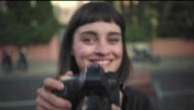
Session Overview
Covid 19 and Lockdown
DofE App and login
Keeping track of activities
Section Evidence
Open Questions

Slide 3

Covid19 and Lockdown
DofE with a Difference
Sectional adaptations
Changing Activities
Activities from home
Assessors
Evidence

Slide 4

Login & Edit Sections
By now, you should have logged into eDofE and submitted the activities for all of your sections.
If not, you can use The DofE APP and this video to get started.

Slide 5

Keeping Track
Throughout your Sections, you should be keeping track and collecting Evidence. This might include:
Activity Log
Photos
Start & End Dates
What you have achieved
You can add evidence each week or at the end of the Section

Slide 6
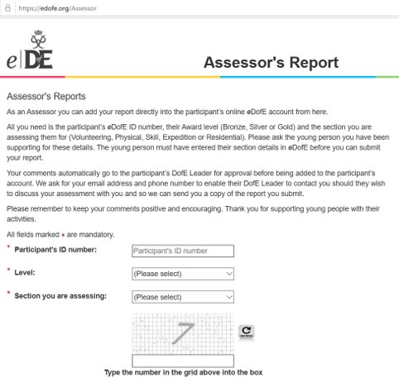
Assessor
The most important evidence will be your Assessor Report at the end of the activity.
Ask them at the start of the Activity
They cannot be a family member
Talk to them about your progress and what you have been doing
Keep track of your regular activity using an Activity Log
They will need to write a short report at the end
Assessor Portal

Slide 7
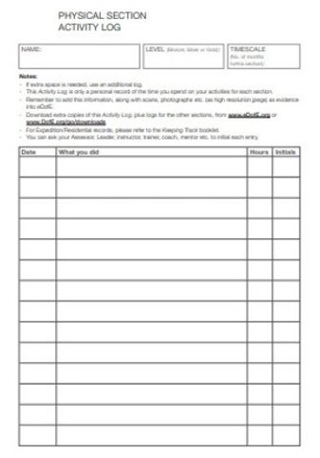
Activity Log
Your Activity Log is a great way to show exactly how often you do your Activity, how long for and what you do each week.
You can fill it in as you go and ask your assessor to sign it at the end.
Your Activity Log must:
Have the same Start and End Dates as your Assessor Report
Show that you completed an average of 1 hour per week for the timescale that you chose (3/6/12/18 months).

Slide 8
Adding Evidence on the DofE APP
The easiest way to add your evidence is using the DofE APP.
Download The DofE APP for free and login with your normal username and password.
This video shows you the whole process from first login.
At 1 min 45, it shows you how to Add Evidence.
For more help with the DofE APP, click here.

Slide 9

Adding Evidence on eDofE.org
If you prefer to upload evidence through eDofE.org, then you will need to take photos of your Evidence and then upload to the website. The video guides you through the process.

Slide 10

Questions?

